Slide 1
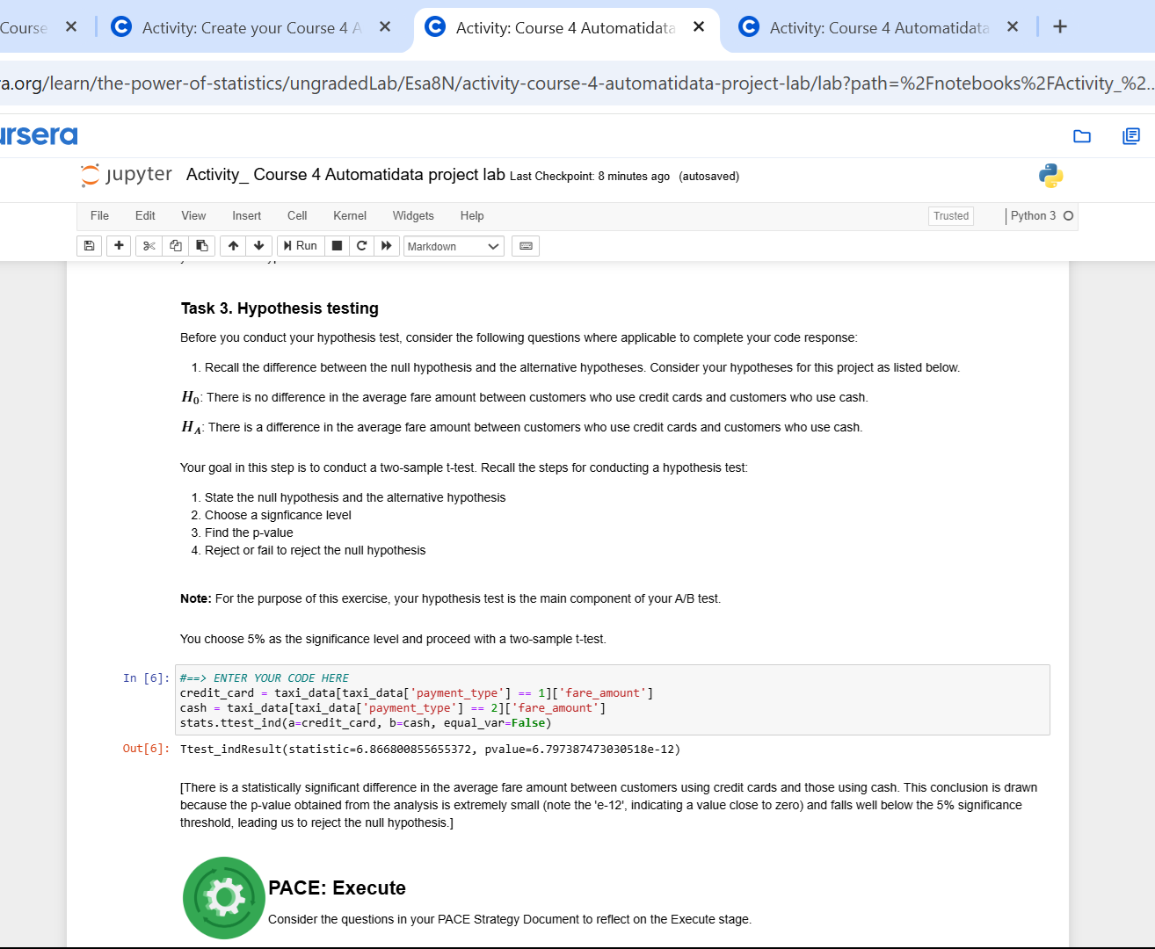
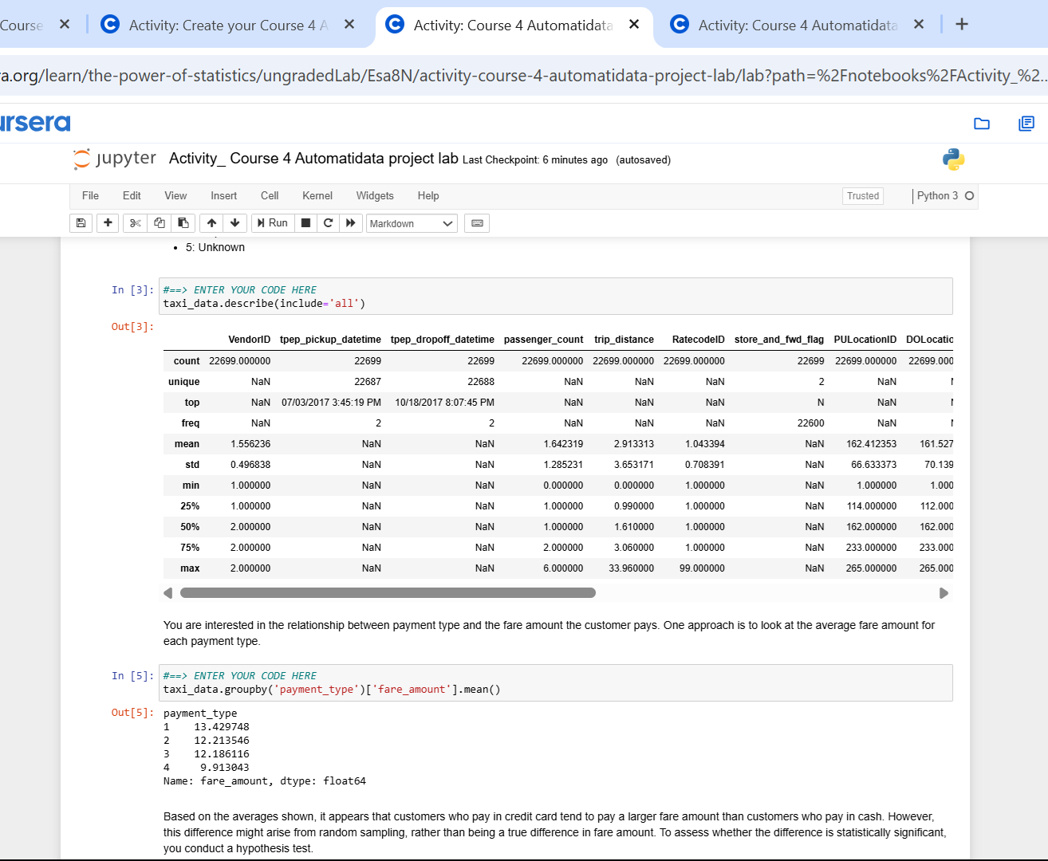
Title:NYC TLC Taxi Data: Analysis of Fare Amount by Payment Type
Subtitle:A/B Test Simulation Findings and Interpretation
The NYC Taxi & Limousine Commission (TLC) requested an analysis to understand the relationship between payment type (credit card vs. cash) and taxi fare amounts, specifically asking whether credit card users tend to pay significantly higher fares, to inform potential business strategies.
To address the TLC's request, a statistical analysis was performed using the 2017 Yellow Taxi dataset; specifically, an A/B test simulation involving a Welch's two-sample t-test was conducted to compare the average fare amounts for rides paid via credit card versus those paid via cash.
Image Alt-Text Here
The hypothesis test revealed a statistically significant difference between the payment groups (p-value ≈ 6.79e-12, which is < 0.05), indicating that the observed difference in average fares ($13.43 for credit card vs. $12.21 for cash in the sample) is unlikely due to random chance alone according to the test parameters.
Image Alt-Text Here
While the statistical test confirms that higher average fares are associated with credit card payments in this dataset, the key insight requires caution: this correlation does not imply causation due to the observational nature of the data and the strong likelihood that external factors, such as trip distance driving up the fare, are what actually influence the choice to use a credit card, rather than the payment type itself determining the fare amount.

